Slide 1
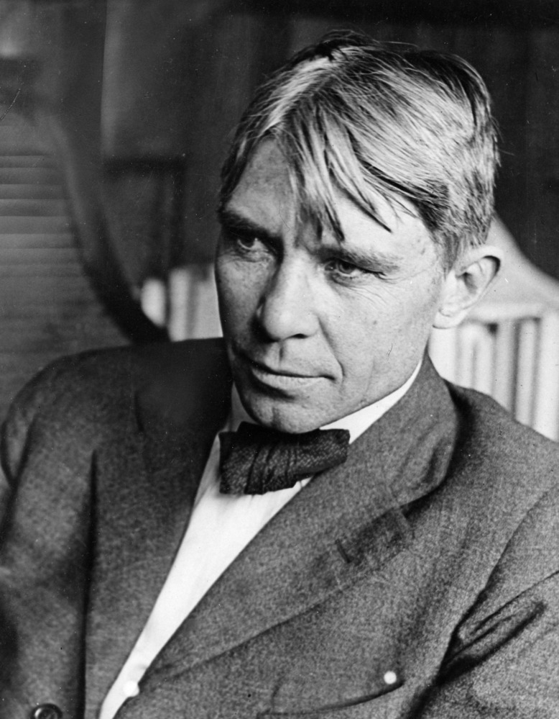
"Poet of the People“
Carl Sandburg provided a popular voice for the American people of the twentieth century and still speaks to us through his words, activism, music and the beauty and serenity of Carl Sandburg Home National Historic Site.
www.nps.gov/carl

Slide 2
Civil Rights: Then and Now
Tasks:
Start with slide 3 to look at an historic photo. Answer the questions on each slide before moving to the next.
Watch the video 1919 Chicago Race Riots.
Look at the historic photographs and read Carl Sandburg’s writing.
Look at a recent photograph of a civil rights event. Answer questions about it using the photographic analysis form.
Write your Tweet about Civil Rights today and submit to your teacher.
How are civil rights similar and different from today to 100 years ago?
This lesson will have you look at an image from a variety of perspectives.
How does your perspective change when you see a portion or the whole picture?

Slide 3
What do you notice about the people in the photograph?
In your opinion, how are they feeling? What evidence supports your answer?

Slide 4
What makes this part of the photograph similar and different from the previous one?
What are the people doing? What details help you to think that?

Slide 5
What do you notice about the people in this photograph?
How are they all connected?

Slide 6
What problem is illustrated in this photograph?
How does the caption change your perspective on the event in this photograph?
White children cheer outside an African American residence that they set on fire.
Bettman Archive/Getty Images

Slide 7
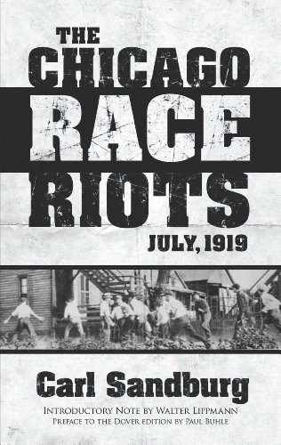
Watch the video 1919 Chicago Race Riots by clicking this link https://www.youtube.com/watch?v=Dktk8nr8IhI
Then look at the historical photographs on the next slides and think about the words that Carl Sandburg wrote.

Slide 8
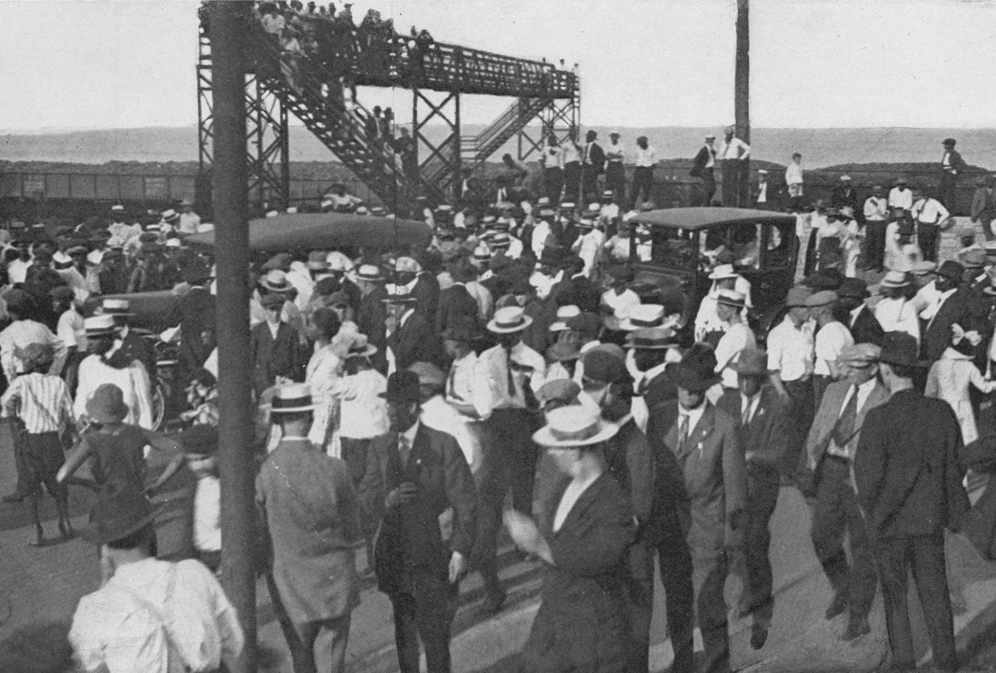
“The so-called race riots in Chicago during the last week in July 1919, started on a Sunday at a bathing beach. A colored boy swam across an imaginary segregation line. White boys threw rocks at him and knocked him off a raft. He was drowned. Colored people rushed to a policeman and asked for the arrest of the boys throwing stones. The policeman refused. As the dead body of the drowned boy was being handled, more rocks were thrown, on both sides. The policeman held on to his refusal to make arrests. Fighting then began that spread to all the borders of the Black Belt. The score at the end of three days was recorded as twenty negroes dead, fourteen white men dead, and a number of negro houses burned.”
--Carl Sandburg “The Chicago Race Riots, July 1919”

Slide 9
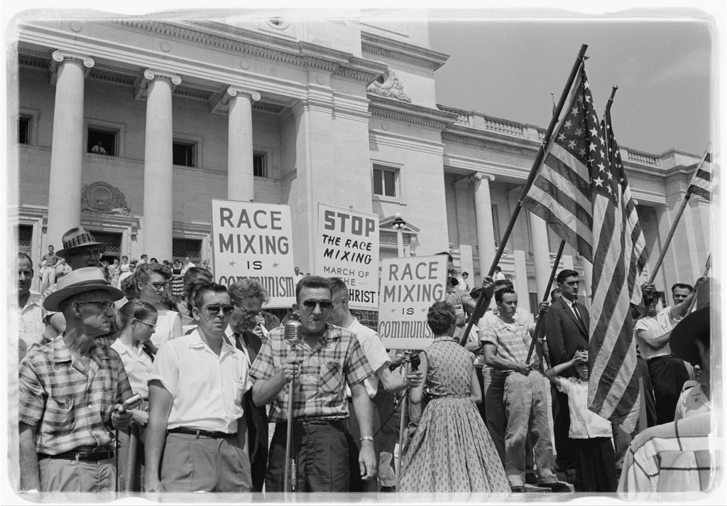
The Liars
By Carl Sandburg
“So I hear The People tell each other:
Look at today and tomorrow,
Fix this clock that nicks off millions
When the Liars say it’s time.
Take things into your own hands.
To hell with ‘em all,
The liars who lie to nations.
The liars who lie to The People.”

Slide 10
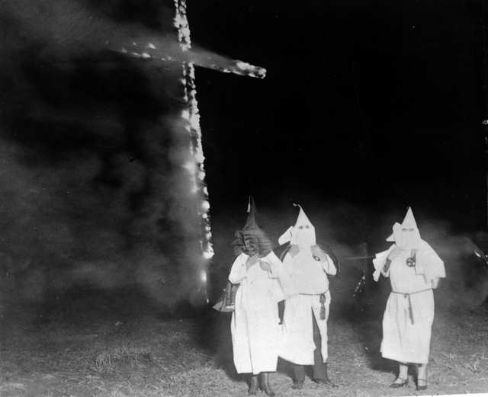
Good Morning America (excerpt)
By Carl Sandburg
“We are afraid. What are we afraid of?
We are afraid of what we are afraid of.”

Slide 11
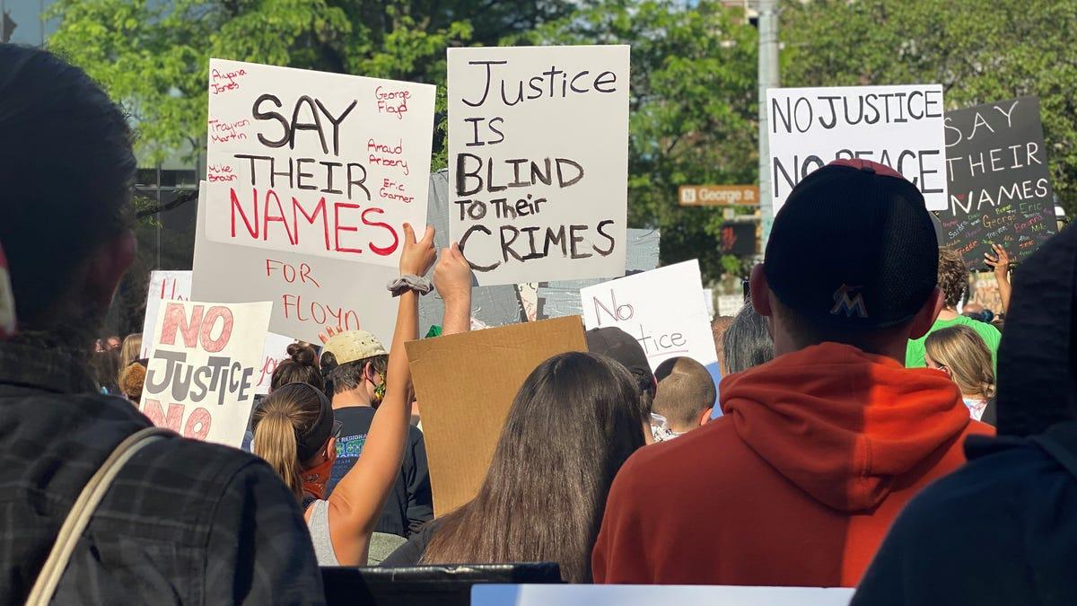
Photographic Analysis
As a journalist, you must be objective and state the facts that you observe, like Carl Sandburg did when he wrote about the Chicago Race Riots in July 1919. Look at the recent photograph on this slide and complete the photographic analysis form on the next page.
Journalist – a person who writes for newspapers, magazines, or news websites or prepares news to be broadcast.

Slide 12
Photographic Analysis Form
Objective Observation | Subjective Observation | Knowledge | Deduction
Describe what you see in the photograph—the forms, structures, arrangement of the various elements. Avoid personal feelings or interpretations. Your description should help someone who has not seen the image to visualize it. | Describe your personal feelings, associations, and judgments about the image. Always anchor your subjective response in something that is seen. For example: I see and it makes me feel...or think... | What prior knowledge do you have that you can associate with this image—prior experience, assumptions, bias, and intuitions. | What conclusions can you make about this photograph?
Questions: What questions does this photograph raise? What else would you need to know?

Slide 13
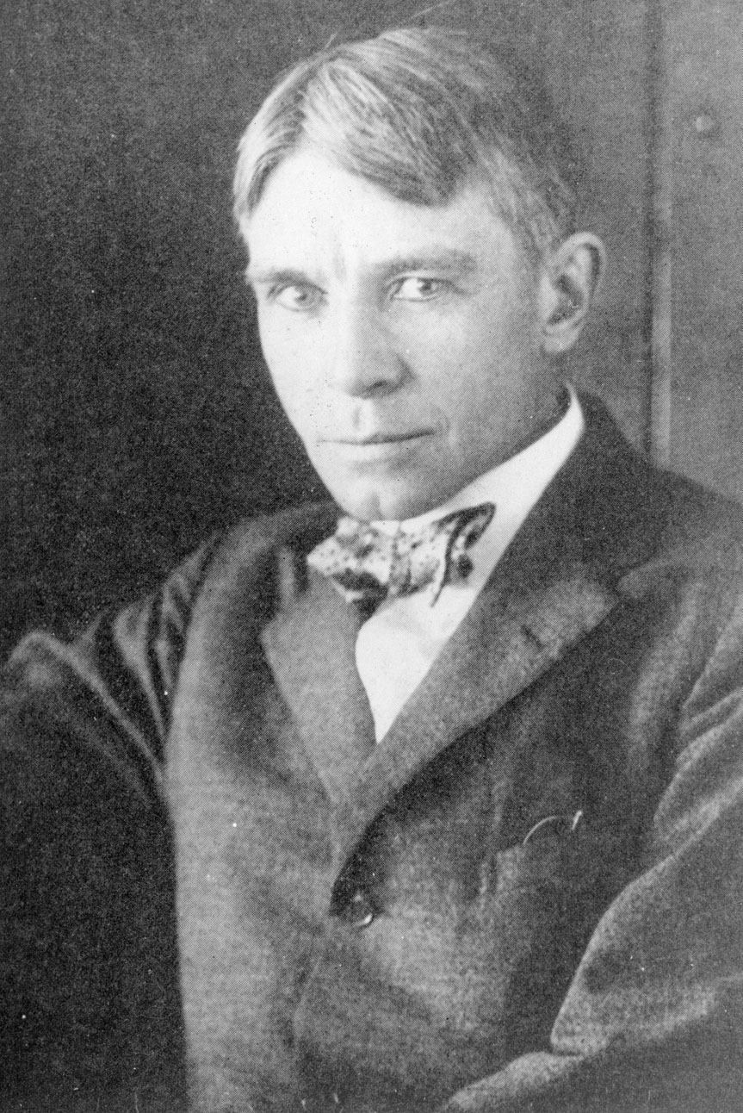
Twitter Talk
This is what Carl might have Tweeted about the Chicago Race Rights in 1919 if Twitter had been around.
After completing the photographic analysis, think about the modern photograph and what you wrote.
Now imagine that you are a journalist Tweeting about civil rights today. What would you say?
Carl Sandburg
@PoetofthePeople
“So on one hand we have blind lawless government failing to function through policeman ignorant of Lincoln, the Civil War, the Emancipation Proclamation, and a theory sanctioned and baptized in a storm of red blood.”
#CivilRights
#TheChicagoRaceRiots

